Slide 1

DEPARTMENT OF COMPUTER SCIENCE AND ENGINEERING
Project name : Public Transport Optimization
Team name : Proj_224782_TEAM_2
Team members :
NELAPATI GAYATHRI
NIKSHITHA PRINCEE
PARVATHAREDDY CHARMILA
PASUPULETI MRUDHULA
(113321104066)
(113321104067)
(113321104070)
(113321104071)

Slide 2
INNOVATION
Multi-Modal Integration: Integrating various modes of transportation, such as buses, trains, trams, and bicycles, to create a seamless and comprehensive public transport network that offers passengers convenient transfer options.
Real-Time Data and Communication: Providing passengers with real-time information on schedules, delays, and vehicle occupancy through mobile apps and digital displays at stations, improving the passenger experience and reducing uncertainty.
Sustainability and Electrification: Transitioning to electric and sustainable modes of transportation to reduce emissions and environmental impact, and investing in green infrastructure for a cleaner and more efficient public transport system.
Demand-Responsive Services: Implementing demand-responsive transit (DRT) and microtransit services to optimize routes, reduce operational costs, and provide more flexible transportation options in areas with varying levels of demand.
Smart Traffic Management: Employing intelligent traffic management systems to prioritize public transport, reduce congestion, and enhance the efficiency and reliability of services.

Slide 3
PROJECT OBJECTIVES
Improving Accessibility: Enhance the accessibility of public transport services to make them available and convenient for a broader range of demographics, including people with disabilities and those in underserved communities.
Reducing Emissions: Minimize the environmental impact of public transport by transitioning to cleaner energy sources, increasing the use of electric vehicles, and adopting eco-friendly infrastructure.
Enhancing Efficiency: Improve the efficiency of public transport systems by optimizing routes, reducing operational costs, and implementing innovative technologies to reduce delays and travel times.
Increasing Ridership: Encourage more people to use public transport by making it a more attractive and user-friendly option through the implementation of mobile apps, fare integration, and improved passenger communication.
Enhancing Safety and Security: Focus on the safety and security of passengers and transit employees by implementing surveillance systems, emergency response protocols, and safety training programs to create a secure and comfortable environment for travelers.

Slide 4
Project Requirements
Sustainable Infrastructure: Prioritize the development and maintenance of sustainable and environmentally friendly transport infrastructure, including the use of electric or low-emission vehicles and renewable energy sources.
Data-Driven Decision-Making: Leverage data collection and analysis to make informed decisions about routes, schedules, and resource allocation. Real-time data can improve efficiency and responsiveness.
User-Centric Approach: Focus on enhancing the passenger experience by providing real-time information, convenient payment options, and accessible, comfortable vehicles and facilities.
Intermodal Integration: Create a well-integrated public transport network that seamlessly connects various modes of transportation, making it easy for passengers to transfer from one mode to another.
Safety and Security: Prioritize passenger and employee safety through robust safety protocols, surveillance systems, and regular training. Security measures should ensure a safe and comfortable environment for all travelers.

Slide 5
Accessibility:
Ensure public transport is accessible to people with disabilities.
Upgrade stations and vehicles to accommodate wheelchairs and other mobility aids.
Provide passenger information in multiple formats for those with visual or hearing impairments.
Fare Integration and Pricing:
Implement integrated fare systems that allow passengers to use a single payment method for multiple modes of transport.
Consider dynamic pricing to optimize revenue and encourage off-peak travel.
Stakeholder Engagement:
Engage with local communities, transportation agencies, and government bodies to gather input and support.
Collaborate with private sector partners for technology and infrastructure solutions.
Monitoring and Evaluation:
Develop performance metrics to monitor the success of the optimization project.
Regularly evaluate the project's impact on ridership, efficiency, sustainability, and other key factors.
Make adjustments and improvements based on data and feedback.

Slide 6
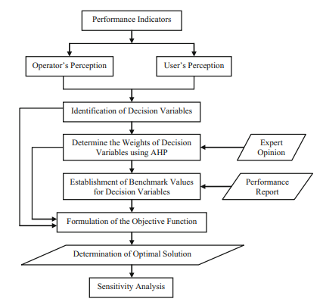
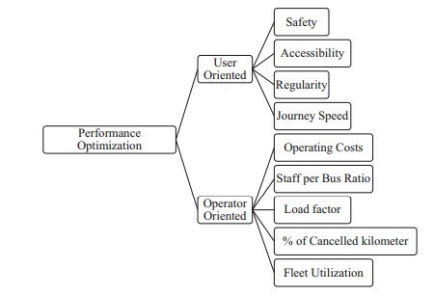
Performance optimization methodology integrating

Slide 7
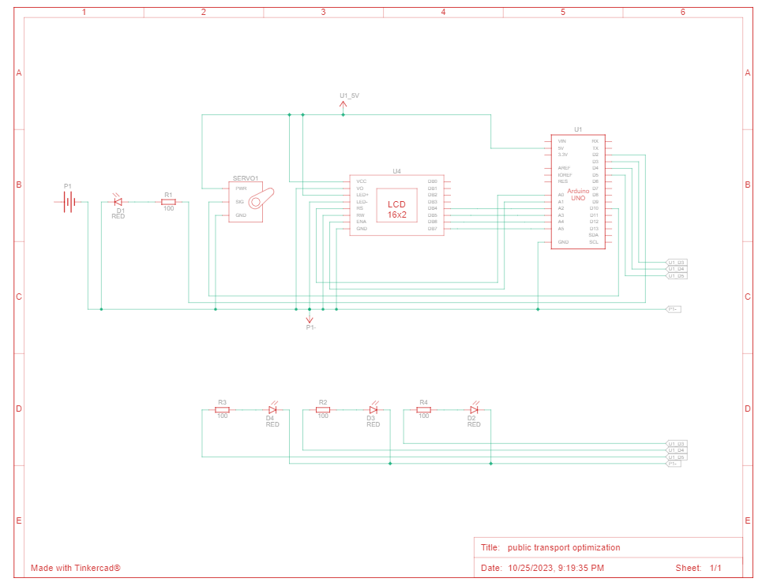
Arduino Integration

Slide 8
CODE IMPLEMENTATION
Python Script Development (On IoT Devices)
Python Script Development (On Central Server)
Hardware Components:
Infrastructure and Vehicle Upgrades
Data Collection and Analysis
Passenger Experience and Communication
Sustainability and Environmental Initiatives
Safety and Security Measures
Software Components:
Vehicle Tracking and Route Optimization
Passenger Information and Communication
Fare Collection and Payment Systems
Safety and Security Software
Data Analytics and Reporting Tools
1. Set Up the Development Environment
2. Import Required Libraries
3. Initialize Device and Sensors
4. Data Collection
5. Data Processing
6. Data Transmission
7. Error Handling
8. Control Logic (If applicable)
9. Logging and Debugging
10. Power Management (If applicable)
11. Testing
12. Documentation
13. Integration with the Central Server
14. Deployment
1. Setting Up the Central Server Environment
2. Importing Required Libraries
3. Data Reception and Storage
4. Data Processing and Analysis
5. Data Visualization
6. User Authentication and Access Control
7. Error Handling and Logging
8. Remote Device Control Logic
9. Security Measures
10. Automation and Script Execution
11. Testing and Debugging
12. Documentation
13. Integration with IoT Devices
14. Deployment and Scaling

Slide 9
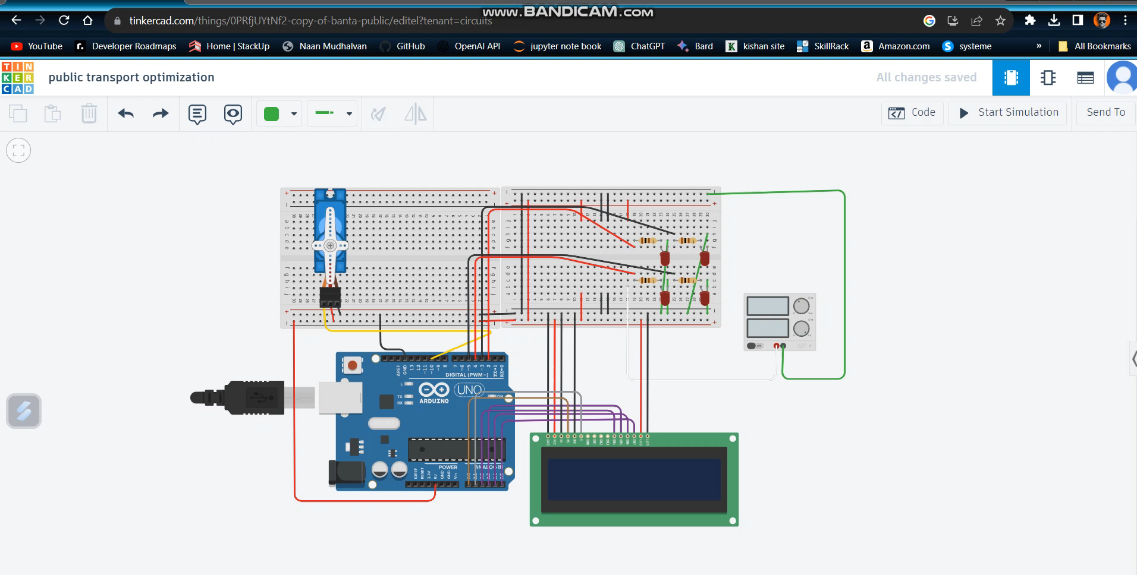
Implementation and Simulation (Watch the simulation video below)

Slide 10
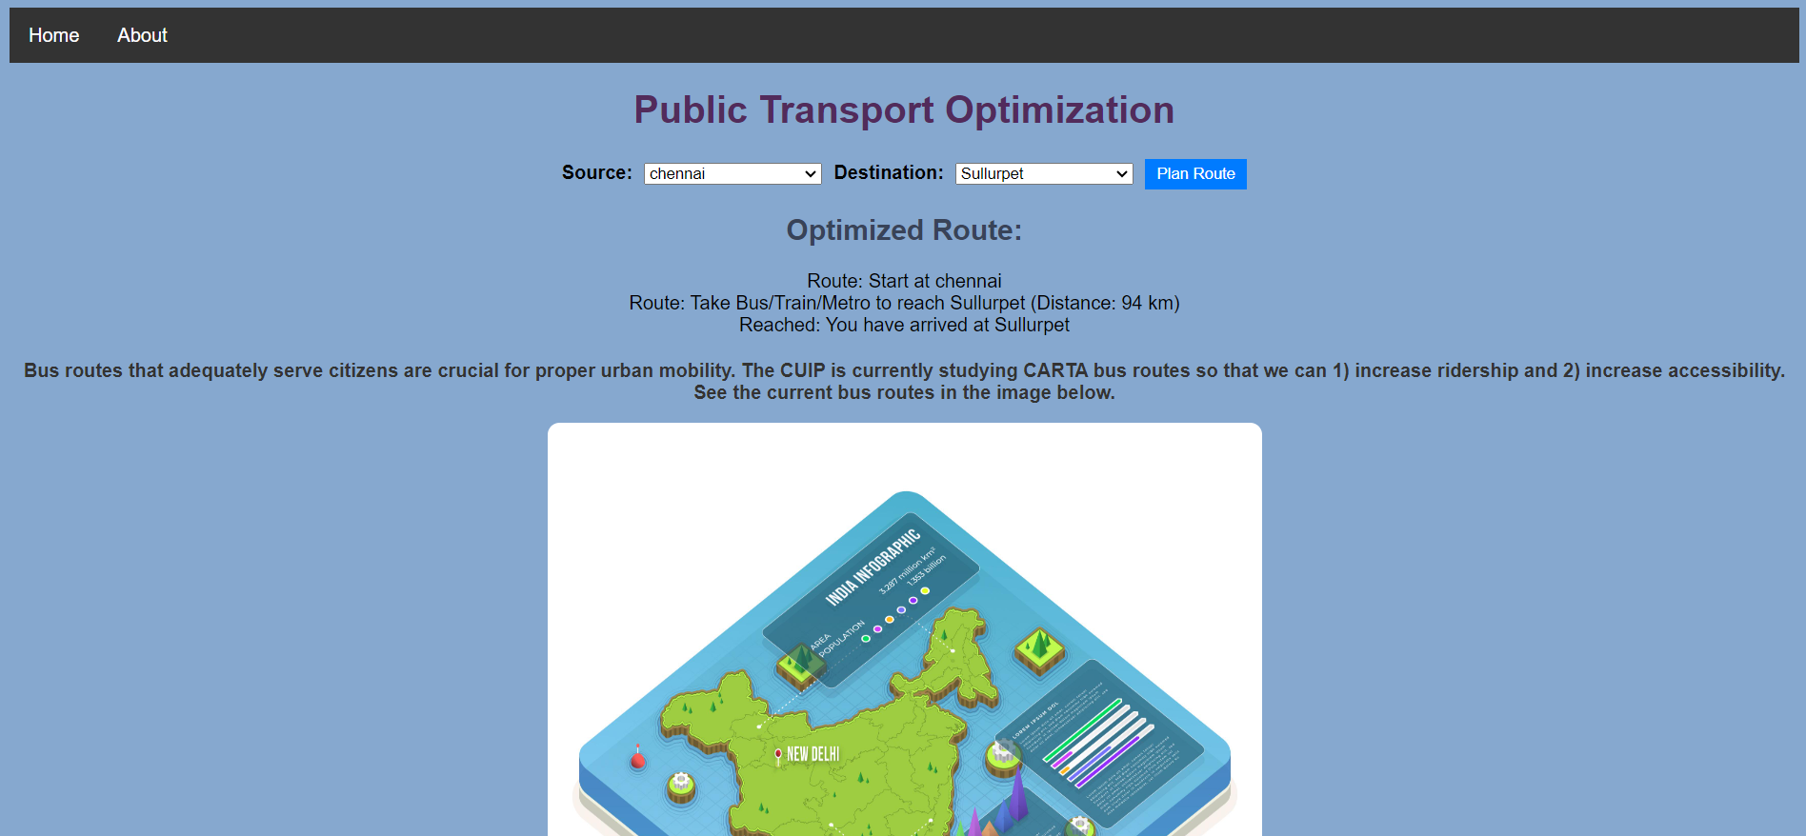
Real-Time Website
Click here to check my website

Slide 11
THANK YOU

